Slide 1
StoryNext 2
Biswaraj Kar - Ling Zhang - Andrew Krischer
Sentiment Analysis for your stories
Biswaraj Kar
Andrew Krischer
Ling Zhang
Fall 2017: CS 6120: Natural Language Processing

Slide 2
Problem Statement
This project aims to help content-writers uncover subtle patterns in their creative work, such as potential biases and overall sentiment. The overall idea is to create a visual analytical tool that processes written content to give unique insights.
Our project goal is to have a visualization (driven by NLP methods) which will show sentiment of a text in an elegant way so that it gives a clear picture of the sentiment of the written text/article/story at a glance and enable the user to get interesting insights just by looking at the visualization.
Input/Output: our project/system takes a piece of text (articles/stories/news-pages) as input and generates a series of sentiment visualizations.

Slide 3
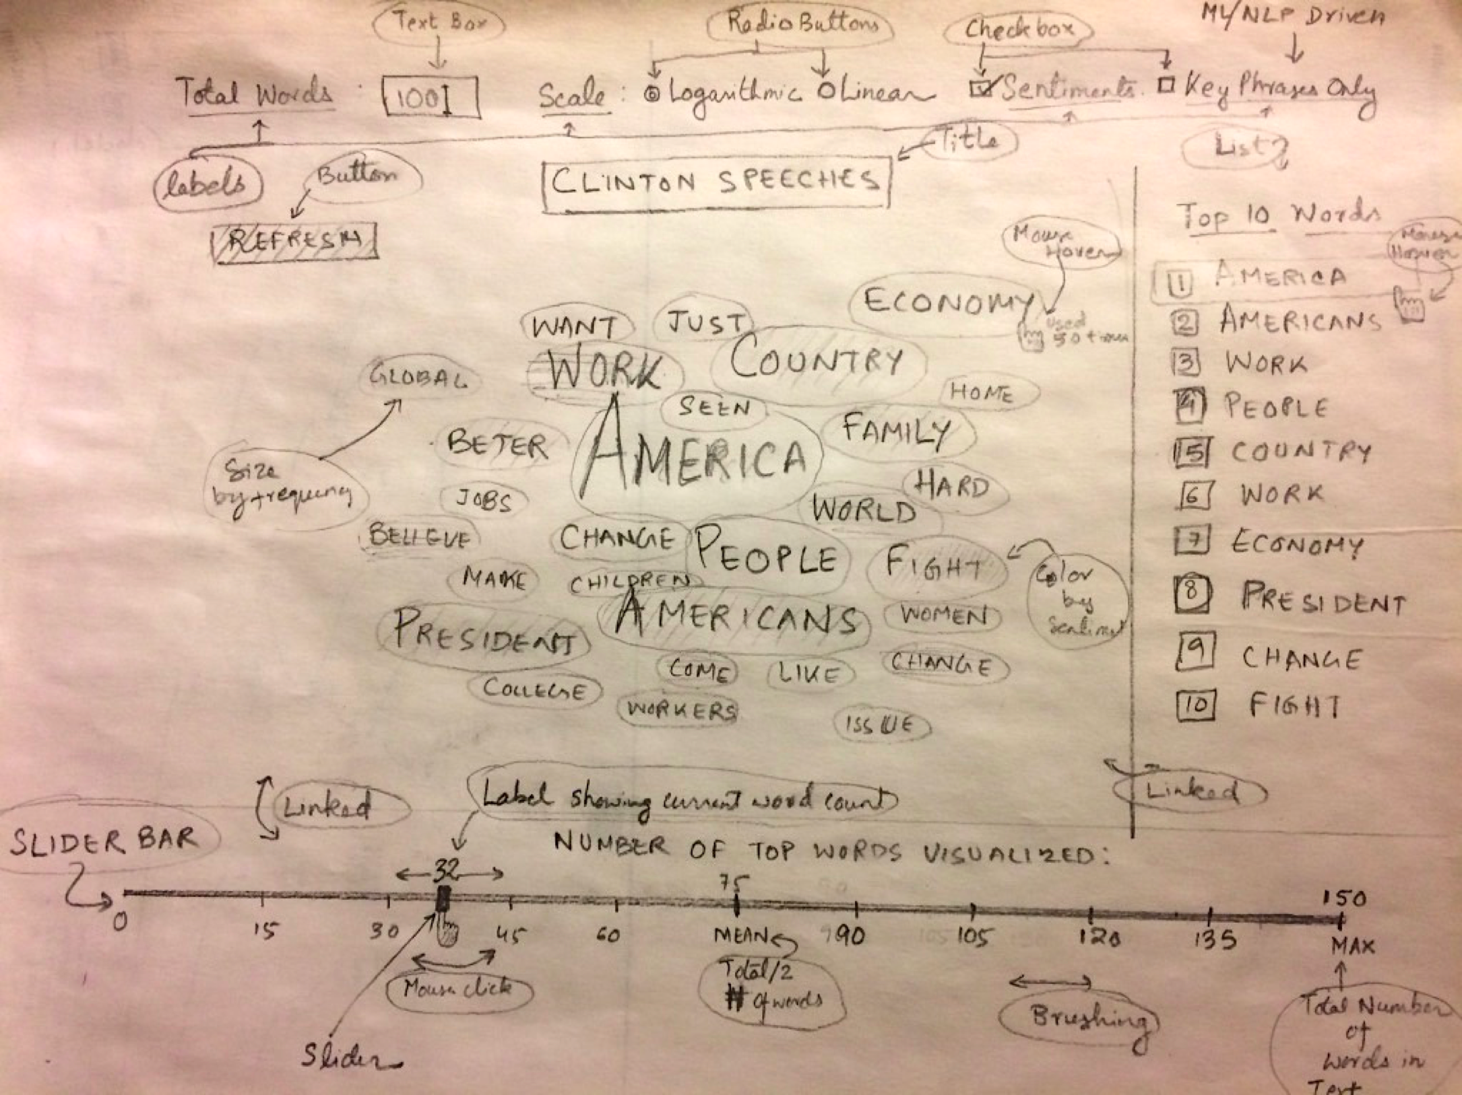
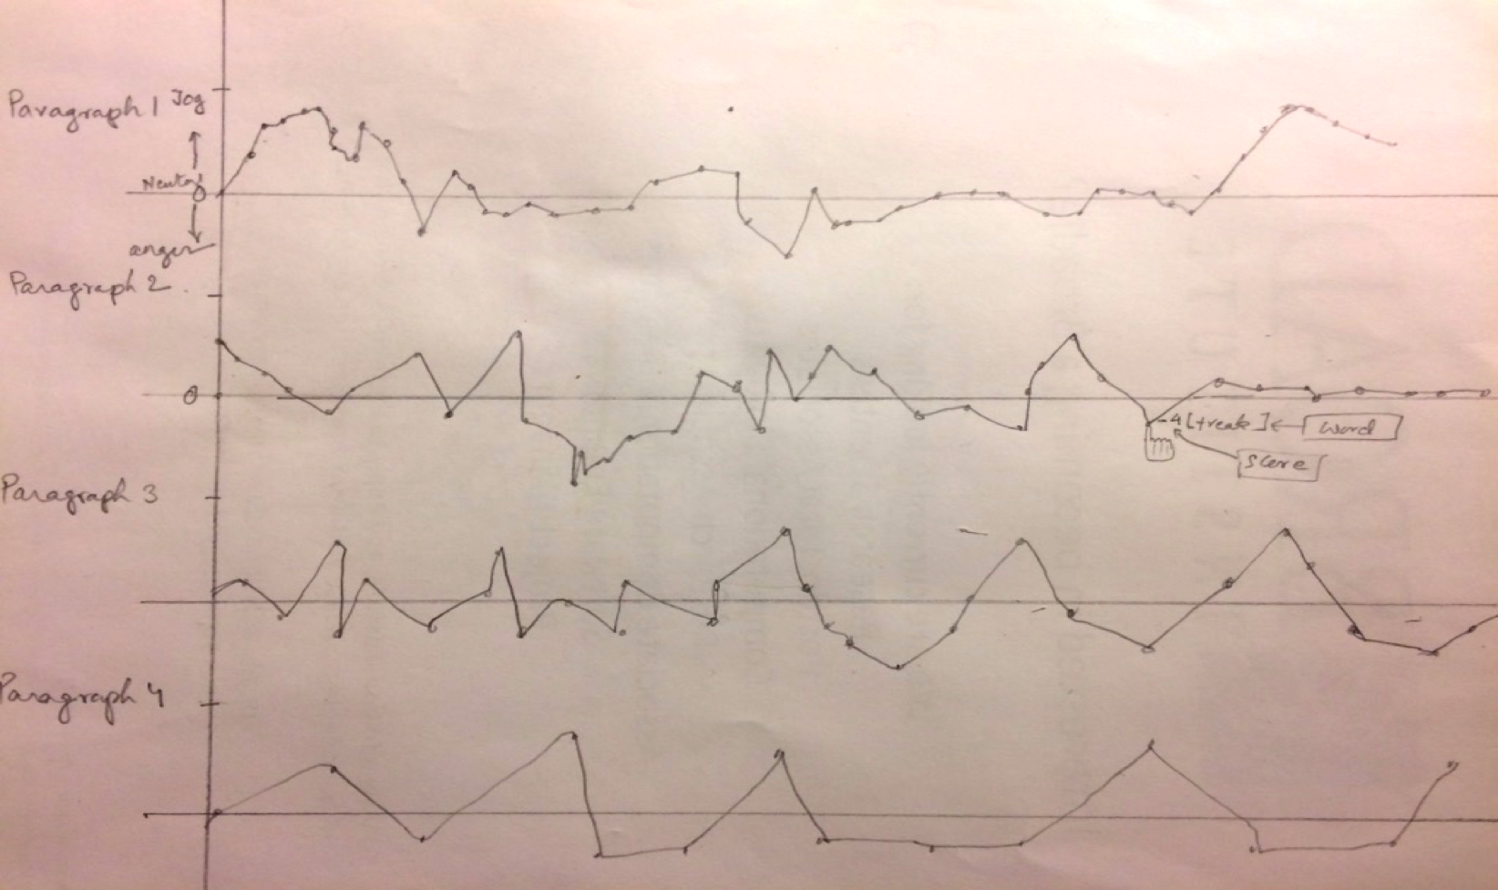
Sketches and Ideas..
Visualize change in sentiment over the entire text
Word cloud to highlight the most emotional words in your text

Slide 4
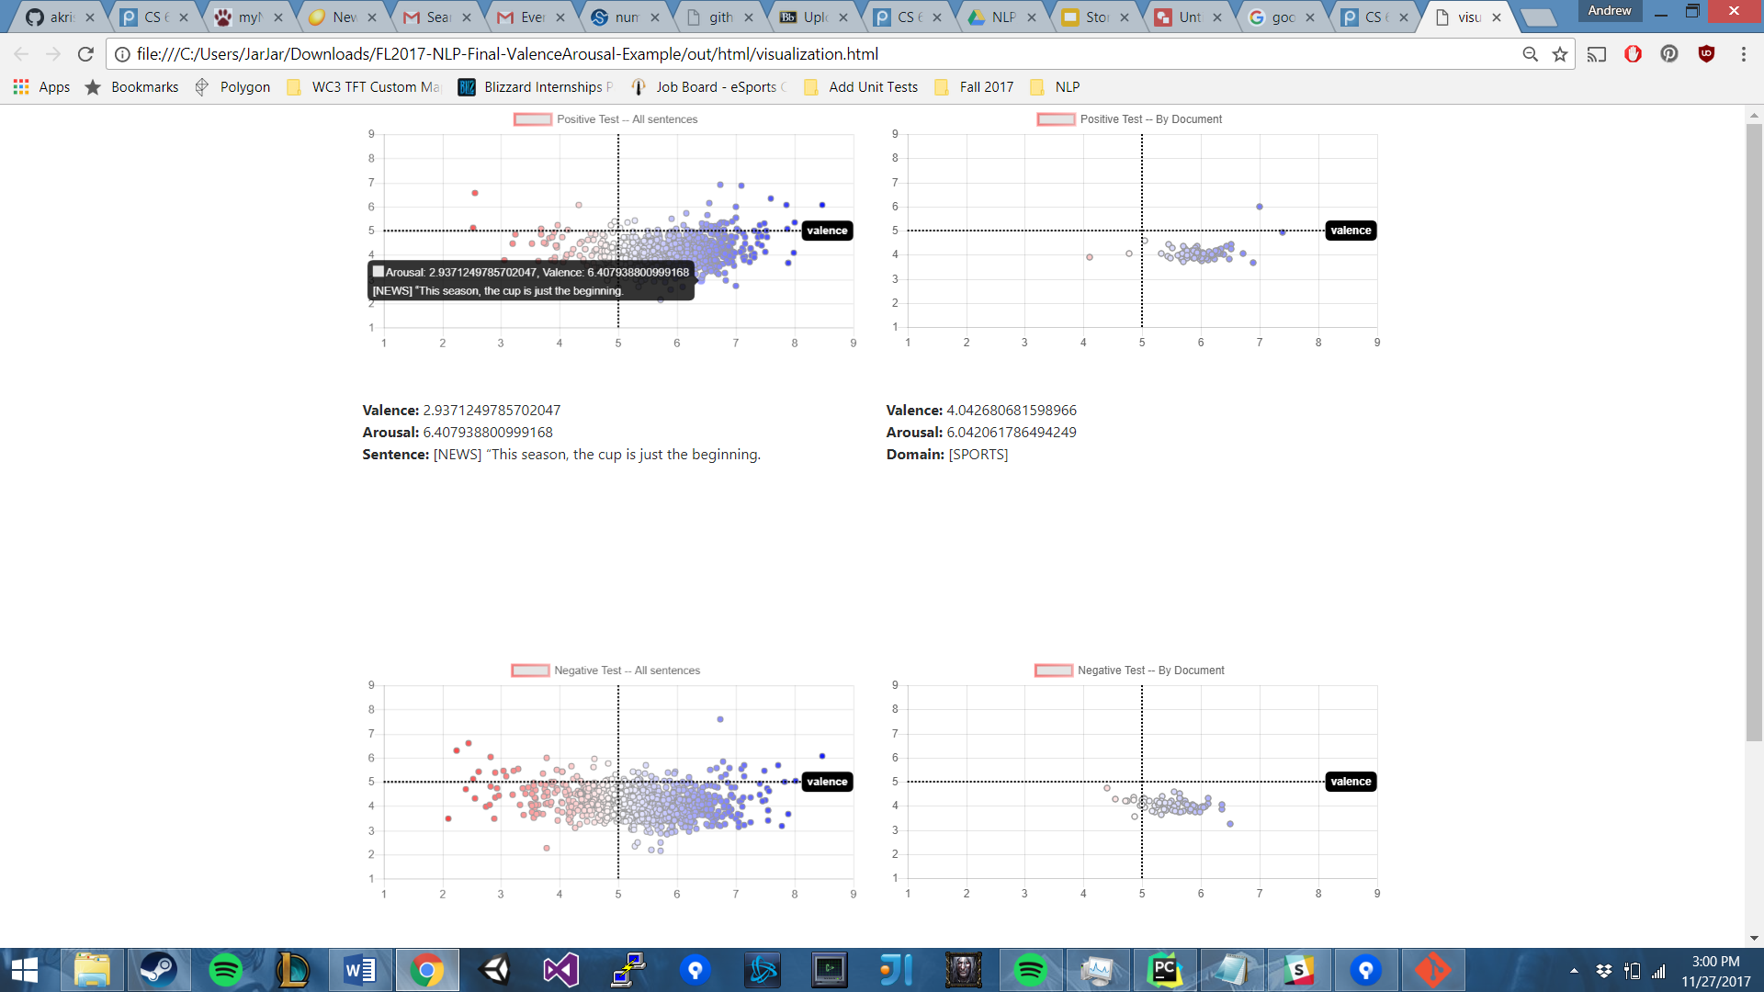
More things...
Visualizing sentiment by document and by sentence:

Slide 5
Reference & Related Works
There have been many papers written on sentiment analysis for the domain of blogs and product reviews.
(Pang and Lee 2008) give a survey of sentiment analysis. Researchers have also analyzed the brand impact of microblogging (Jansen). (Pang and Lee 2002) researched the effects of various machine learning techniques (Naive Bayes (NB), Maximum Entropy (ME), and Support Vector Machines (SVM)) in the specific domain of movie reviews.
We could not find any papers that analyzes NLP techniques in the specific domain of story writing or journalism, probably because digital story-telling and real-time opinion mining is a relatively new field. That is where our project comes as a new attempt.

Slide 6
Data Sources
Training: Movie Review Data
http://www.cs.cornell.edu/people/pabo/movie-review-data/ : Pang and Lee dataset
http://ai.stanford.edu/~amaas/data/sentiment/ : IMDB11 Dataset: 25k Movie Reviews from IMDB
Testing:
We hand-tagged 150 articles (75 positive + 75 negative) with 25 articles each from Literature, Politics and Sports news; to be used as test for our methods/models.

Slide 7
Methodology
Main challenges:
No annotated data for literature or news.
Sentiment classification is hard, specially due to the versatility of language.
Hand-tagging data was the only way out to have some reliable test baselines to fall back on.
Hence, due to the lack of pre-annotated data, it became clear that we have to take the path of cross-domain analysis for your project and evaluate, what best fits our purpose.
Extending our intuition and plan in the proposal, we started with the Unigram and Bigram models for feature representation of our data.
As a first step for classification, we used Naive Bayes classifier to train on the movie review corpus of 25k IMDB reviews. Post which we tried SVM, RNN and a linguistic model using ‘Valence & Arousal model.

Slide 8
Methodology 1: Naive Bayes
The simplest approach to text classification is to assign to a given document d, the class c* = arg maxc P( c | d)
We derive the Naive Bayes (NB) classifier by first observing that by Bayes’ rule,
P (c | d ) = P (c )P (d | c )/ P (d )
Despite its simplicity and the fact that its conditional independence assumption clearly does not hold in real-world situations, Naive Bayes-based text categorization still tends to perform surprisingly well (Lewis, 1998 & Pang & Lee 2008) when the domains of training and test are same; however, the same doesn’t quite work well when we ran the model on cross domain data like ours.
Thus, it became clear that we have to try other methods.

Slide 9
Naive Bayes: Result
NB | Precision | Recall | F1 | Expecting
Neg | 0.52 | 0.47 | 0.50 | 75
Pos | 0.52 | 0.56 | 0.54 | 76
Average | 0.52 | 0.52 | 0.52 | 151
The accuracy is 52% and clearly not very impressive, so we decided to use Naive Bayes as the baseline.

Slide 10
Methodology 2: SVM and Random Forest
The next attempt after Naive Bayes took us to Support vector machines (SVMs). SVMs have been shown to be highly effective at traditional text categorization. They are large-margin (choose the best hyperplane which represents the largest separation), rather than probabilistic, classifiers, in contrast to Naive Bayes.
SVM has inherently a linear decision boundary and hence the natural formulation of SVMs lends itself well for a 2 class classification problem, like ours.
Random Forest is intrinsically suited for multiclass problems, while SVM is intrinsically two-class. But we give Random forest a try.
Notes:
Svm are large-margin which will might possibly increase the accuracy
svm has inherently a linear decision boundary. It’s a good way to solve binary classification. It fits our project pretty well.
also we found some paper also use this approach. and we are trying to see if it can improve from naive bayes

Slide 11
SVM versus Random Forest: Result
SVM | Precision | Recall | F1 | Expecting
Neg | 0.60 | 0.53 | 0.56 | 75
Pos | 0.58 | 0.64 | 0.61 | 76
Average | 0.59 | 0.59 | 0.59 | 151
RF | Precision | Recall | F1 | Expecting
Neg | 0.62 | 0.32 | 0.42 | 75
Pos | 0.54 | 0.80 | 0.65 | 76
Average | 0.58 | 0.56 | 0.54 | 151
Notes:
Svm works a little better than random forest, but neither of them give a satisfying result.

Slide 12
SVM versus Random Forest: Analysis
Assumption for poor result for Random Forest. (parameter/better performance on multiple field classifying)
Future enhancement on feature extracting. (besides tf-idf)
Notes:
number of jobs number of trees maximum depth
Random Forest usually works better on multiple classification
TF-IDF is based on the bag-of-words (BoW) model, therefore it does not capture position in text, semantics

Slide 13
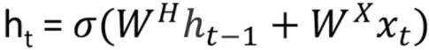
Methodology 3: RNN
In general, neural networks use arrays of pixel values, logistic regression uses quantifiable features, and reinforcement learning models use reward signals. The common theme is that the inputs need to be scalar values, or matrices of scalar values.
The unique aspect of NLP data is that there is a temporal aspect to it. Each word in a sentence depends greatly on what came before and comes after it. In order to account for this dependency, we use a recurrent neural network.
In RNNs, each word in an input sequence will be associated with a specific time step:
The hidden state is a function of both the current word vector and the hidden state vector at the previous time step. xt is a vector that encapsulates all the information of a specific word, ht is a vector that summarizes information from previous time steps.
Notes:
For example, we’d like the vectors for the words “love” and “adore” to reside in relatively the same area in the vector space since they both have similar definitions and are both used in similar contexts. The vector representation of a word is also known as a word embedding.
The hidden state is a function of both the current word vector and the hidden state vector at the previous time step. The sigma indicates that the sum of the two terms will be put through an activation function (normally a sigmoid or tanh). The 2 W terms in the above formulation represent weight matrices. If you take a close look at the superscripts, you’ll see that there’s a weight matrix WX which we’re going to multiply with our input, and there’s a recurrent weight matrix WH which is multiplied with the hidden state vector at the previous time step. WH is a matrix that stays the same across all time steps, and the weight matrix WX is different for each input. The magnitude of these weight matrices impact the amount the hidden state vector is affected by either the current vector or the previous hidden state. As an exercise, take a look at the above formula, and consider how ht would change if either WX or WH had large or small values. Let's look at a quick example. When the magnitude of WH is large and the magnitude of WX is small, we know that ht is largely affected by ht-1 and unaffected by xt. In other words, the current hidden state vector sees that the current word is largely inconsequential to the overall summary of the sentence, and thus it will take on mostly the same value as the vector at the previous time step. The weight matrices are updated through an optimization process called backpropagation through time. The hidden state vector at the final time step is fed into a binary softmax classifier where it is multiplied by another weight matrix and put through a softmax function that outputs values between 0 and 1, effectively giving us the probabilities of positive and negative sentiment.

Slide 14
Methodology 3: RNN...
Basic Steps:
Training a word vector generation model or loading pre-trained word vectors: GloVe vectors, 400,000 word vectors, each with a dimensionality of 50.
Creating an ID's matrix for our training set: convert each document into a vector representation by using the word embeddings
RNN (With LSTM units) graph creation: specify two placeholders, one for the inputs into the network, and one for the labels.
Training: We load in a batch of reviews and their associated labels. Next, we call the TF session’s run function with our optimizer and the input placeholders. This loop is then repeated for a set number of training iterations.
Testing

Slide 15
Results: RNN
We found pretty impressive results for some of our hyper parameters:
Optimizer | Learning Rate | Iterations | Average Accuracy of Batches | Peak Accuracy in Batches
Adam | 0.1 | 30000 | 62% | 69%
Adam | 0.01 | 10000 | 67% | 71%
Adam | 0.01 | 50000 | 62% | 70%
Gradient Descent | 0.1 | 70000 | 64 % | 75%
Gradient Descent | 0.1 | 50000 | 72% | 79%
Gradient Descent | 0.2 | 50000 | 68% | 79%

Slide 16
Methodology 4: Valence & Arousal
Apart from the standard language models we tried before, recent research has suggested an alternative method to the use of dictionaries that report the sentiment of a set of words along one or more emotional dimensions.
Examples of sentiment dictionaries includes POMS^{[8]} and POMS-ex—Profile of Mood States—and ANEW—Affective Norms for English Words.
Given our relatively average success with all the language models discussed before, we chose to give a Linguistic model a try and use ANEW, with an extended ANEW dictionary^{[6]} that was recently built by researchers McMaster and Ghent Universities.

Slide 17
Methodology 4: Valence & Arousal...
Advantages
Domain-independent
Qualitative
No Training!
Disadvantages
Basically just a word dictionary
Misses structural (contextual) clues
Notes:
NC State University - Computer Science
ANEW dictionary built by McMaster and Ghent universities
Intuition:
Texts are qualitative, they are colored by language
If a text is a painting, language models look at the brush strokes; this model looks at the colors
Challenges:
Limited dictionary
Negation -- e.g. “I’d hate to see you go!”, here “hate” is used affectionately
Feature Extraction:
Negation: Identify negation tokens using nltk, and reverse the following token’s valence
Weight by frequency: Words in the dictionary with high frequency == higher confidence? But it made the results worse

Slide 18
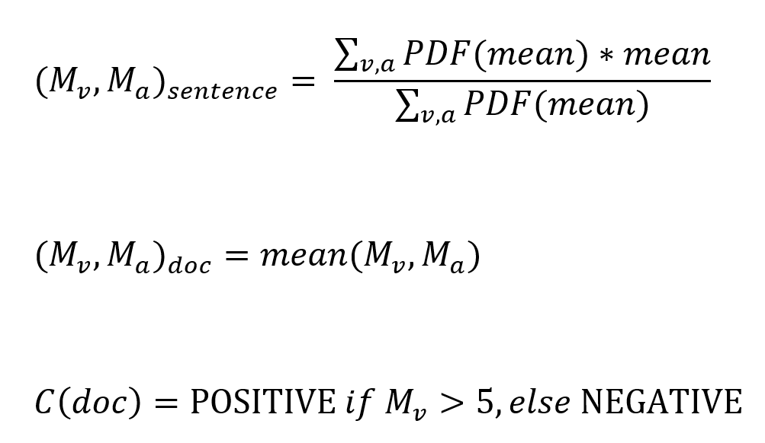
Methodology 4: Valence & Arousal ...
Notes:
PDF is a way to weight means based on standard deviation
Scale is between 1 and 9, so 5 is the halfway point!

Slide 19
Results: Valence & Arousal
V&A | Precision | Recall | F1 | Accuracy | Expected
Neg | 0.82 | 0.12 | 0.21 | .55 | 75
Pos | 0.53 | 0.97 | 0.69 | .55 | 76
Average | 0.67 | 0.55 | 0.45 | .55 | 151
Poor quantitative results, but let’s look at it qualitatively...
Notes:
Results of running the classifier on our 151 test data.
Not super interesting, accuracy of 55% isn’t too bad.
Low Recall, High Precision == Classifier is way too picky. It won’t recognize most of the actual neg. texts, but when it does it’s usually correct.

Slide 20

Demo Time!

Slide 21
References
[1] Bo Pang, Lillian Lee, and Shivakumar Vaithyanathan. 2002. Thumbs up?: sentiment classification using machine learning techniques. In Proceedings of the ACL-02 conference on Empirical methods in natural language processing - Volume 10 (EMNLP '02), Vol. 10. Association for Computational Linguistics, Stroudsburg, PA, USA, 79-86. DOI: https://doi.org/10.3115/1118693.1118704
[2] C. Yang, K. H. Y. Lin and H. H. Chen, "Emotion Classification Using Web Blog Corpora," Web Intelligence, IEEE/WIC/ACM International Conference on, Fremont, CA, 2007, pp. 275-278.
[3] Christopher D. Manning and Hinrich Schütze. 1999. Foundations of Statistical Natural Language Processing. MIT Press, Cambridge, MA, USA.
[4] Peter D. Turney. 2002. Thumbs up or thumbs down?: semantic orientation applied to unsupervised classification of reviews. In Proceedings of the 40th Annual Meeting on Association for Computational Linguistics (ACL '02). Association for Computational Linguistics, Stroudsburg, PA, USA, 417-424. DOI: https://doi.org/10.3115/1073083.1073153
[5] Socher, R., Perelygin, A., Wu, J., Chuang, J., Manning, C. D., Ng, A., & Potts, C. (2013). Recursive deep models for semantic compositionality over a sentiment treebank. In Proceedings of the 2013 conference on empirical methods in natural language processing (pp. 1631-1642).
[6] Norms of valence, arousal, and dominance for 13,915 English lemmas. Warriner AB, Kuperman V, Brysbaert M. Behav Res Methods. 2013 Dec;45(4):1191-207. DOI: 10.3758/s13428-012-0314-x. PMID: 23404613

Slide 22
References..
[7] Dodds PS, Harris KD, Kloumann IM, Bliss CA, Danforth CM (2011) Temporal Patterns of Happiness and Information in a Global Social Network: Hedonometrics and Twitter. PLoS ONE6(12): e26752. https://doi.org/10.1371/journal.pone.0026752
[8] L. Curran, Shelly & A. Andrykowski, Michael & Studts, Jamie. (1995). Short form of the Profile of Mood States (POMS-SF): Psychometric information. Psychological Assessment. 7. 80-83. 10.1037/1040-3590.7.1.80.
[9] Yoonjung Choi and Janyce Wiebe (2014) +/-EffectWordNet: Sense-level Lexicon Acquisition for Opinion Inference, Proc. of EMNLP 2014.
[10] Janyce Wiebe, Theresa Wilson , and Claire Cardie (2005). Annotating expressions of opinions and emotions in language. Language Resources and Evaluation, volume 39, issue 2-3, pp. 165-210.

Slide 23
Thank You!

